Slide 1



Diana
Suryani M.
A professional Recruitment Consultant with 4 years of experience in Multi Industry, especially IT, Startups, E-commerce Industries. Expertise in handling Tech and Non-Tech positions for Corporation up to Decacorn Companies. Currently focus on helping others to prepare their career development for Shifting Career .
{
Education Background
Diana Suryani M.
4 Years Experience as Recruiters and Tech Consultant
2014-2018
Bachelor Degree
Notes:
Diisi perkenalan tutor, memang ditaruh di awal untuk perkenalan dalam video sebelum masuk ke materi

Slide 2
Career Shifting Preparation (CSP)
Understanding Career Shifting: The Opportunity and Consequences

Slide 3
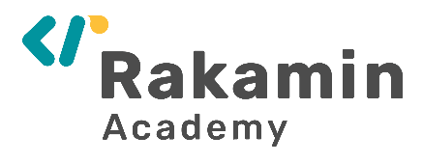

Outline Pembelajaran
Understanding Career Shifting: The Opportunity and Consequences
How the world is changing right now?
Defining our goals and market needs
Understanding the Opportunities for Digital Jobs
Career Maturity
Understanding the Career Stages
How is your Career Readiness?
Understanding the Consequences for Career Shifting
Rakamin Profiler
Notes:
Diisi seluruh subtopik yang akan dipelajari

Slide 4


The world is changing so fast,
We can’t use the ‘old wisdom’ to face and win today disruption

Slide 5



Slide 6
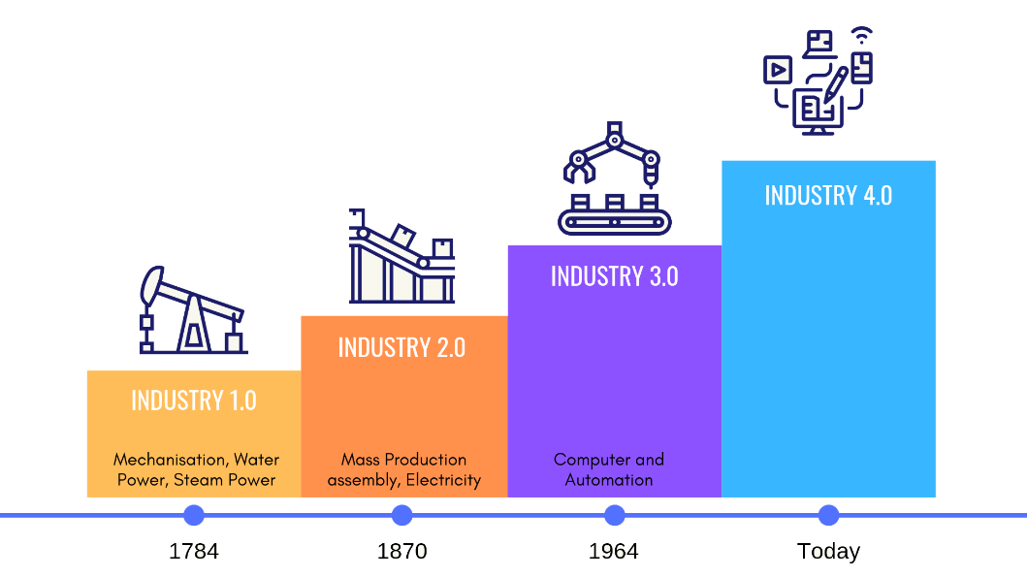

4.0 Industrial Revolution
Is the Biggest and Most Holistic Revolution Ever
Industry 4.0 is the most accessible and affordable for all industry
+
COVID 19
Integrated digital ecosystem and connectivity

Slide 7
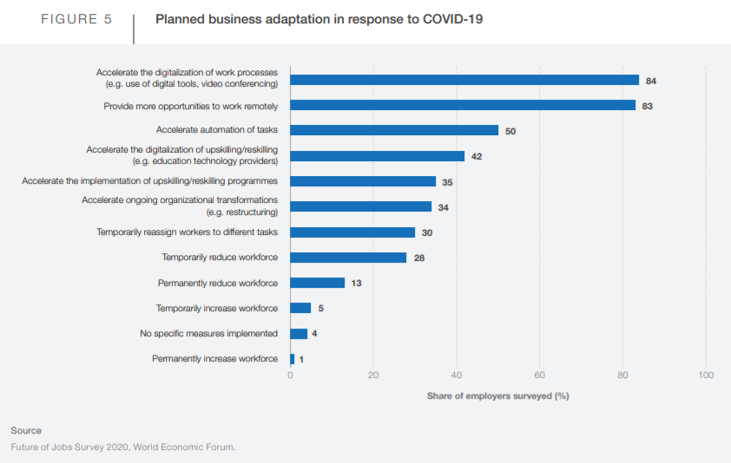

Slide 8
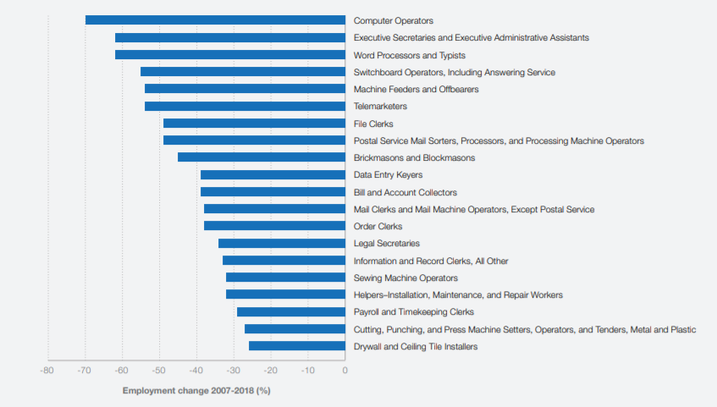
Jobs with decreasing demand

Slide 9
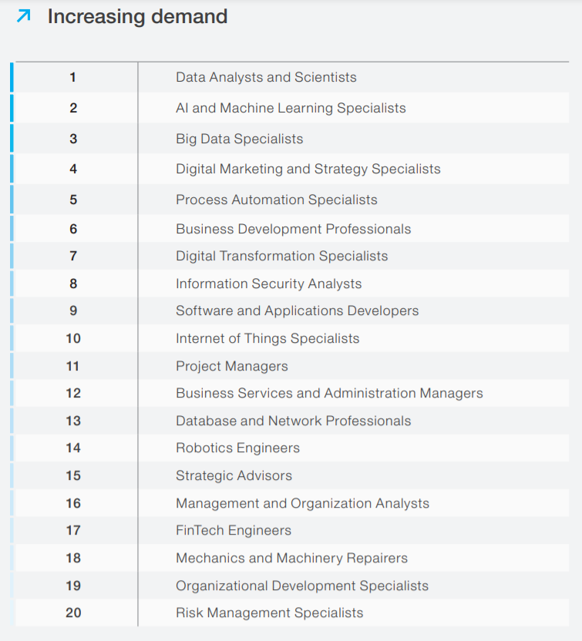

Slide 10
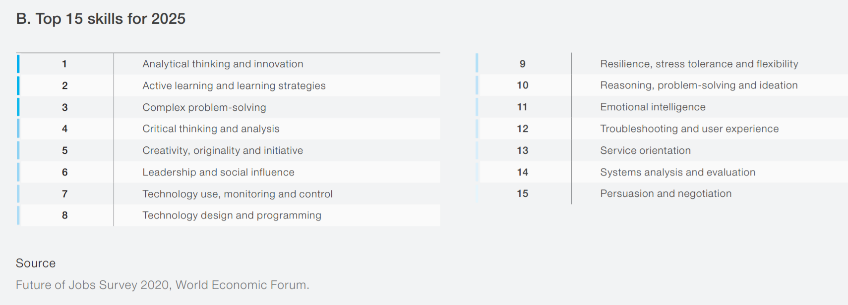

Slide 11




World becoming
Volatile, Unpredictable, Complex, Tech-heavy, Data-driven, Interconnected
Companies Strategy
Need to transform and adopt new technology
Recruit and retain high quality talents in fast, reliable, and measurable way
Become agile and more adaptive to rapid change

Slide 12
But, is Indonesia Ready?

Slide 13

The Urgent Problems Indonesia Workforce Condition
2+ Mio
Talent Shortage in Tech, Digital, Finance, and Manufacture each year
(BCG & Korn Ferry 2019)
46,6%
Workforce matched with industry needs
(INDEF, 2019)
Industry Problems
21,76%
Unemployment came from vocational & universities
(BPS 2020)
4,2 Mio
Graduates from high school and universities each year, that prepared for old job desc
(Coordinating Ministry for Human Development and Culture 2019)
Students Problems

Slide 14
There’s lot of challenges in disruption, but there’s also opportunities
It’s up to us to choose between riding the wave, or just waiting and drowning

Slide 15

Outline Pembelajaran
Understanding Career Shifting: The Opportunity and Consequences
How the world is changing so fast?
Defining our goals and market needs
Understanding the Opportunities for Digital Jobs
Career Maturity
How is your Career Readiness?
Understanding the Career Stages
Understanding the Consequences for Career Shifting
Rakamin Profiler
Notes:
Diisi seluruh subtopik yang akan dipelajari

Slide 16




Digital Marketing Opportunities
Digital Marketing is now used widely across industries
Digital Marketing roles increase up-to 50% each year
Scarcity for Digital Marketing talent is still high
Side hustling and increasing earning is widely open
Notes:
note

Slide 17
Digital Marketing is also accommodating many working styles
Content-related
(creative, artistic, conceptual)
Analysis-related
(investigative, problem-solving, data-driven)
Optimization-related
(operational, creative, experimental)
Service-related
(operational, personal touch, empathizing)
Notes:
note

Slide 18
In order to have clarity and better understanding about how big the opportunity is, we need to understand: the market needs
It also helps us to prepare our career plan more vividly.

Slide 19



How to understand the market needs?
Do research!
Search for your future job field at many source: Google, job portal, career page of your desired company, networking, etc.
See all the relevance Job that might related
Read a lot!
The more you read the requirements, the more you familiar with the tools and needs they are preferred. And each company may have different requirements and needs
Classification!
Make yourself aware about the needs and increase the feel of importance to achieve it by writing it down.
It also helps you to bring up clarity in your career plan.
Notes:
note

Slide 20
Let’s do it!
Notes:
Dicontohin utk tipe company beda, yg wellknown, dan gatau siape tu

Slide 21
But, from every opportunity, there’s an option to take, and from every option, there’s always a consequence: the price to pay

Slide 22
Outline Pembelajaran
Understanding Career Shifting: The Opportunity and Consequences
How the world is changing so fast?
Defining our goals and market needs
Understanding the Opportunities for Digital Jobs
Career Maturity
Understanding the Career Stages
How is your Career Readiness?
Understanding the Consequences for Career Shifting
Rakamin Profiler
Notes:
Diisi seluruh subtopik yang akan dipelajari

Slide 23
There’s lot of challenges in disruption, but there’s also opportunities
It’s up to us to choose between riding the wave, or just waiting and drowning

Slide 24
Career Stages at Work
How our career stage may affect the transition and change
Linear throughout life
Exploration stage
School-to-work stage
→ self-examination and education fulfillment
Establishment stage
Employed & finding a niche and specialization
Maintenance Stage
Learning & updating skills in specific field
Disengagement Stage
Retirement
Notes:
note

Slide 25
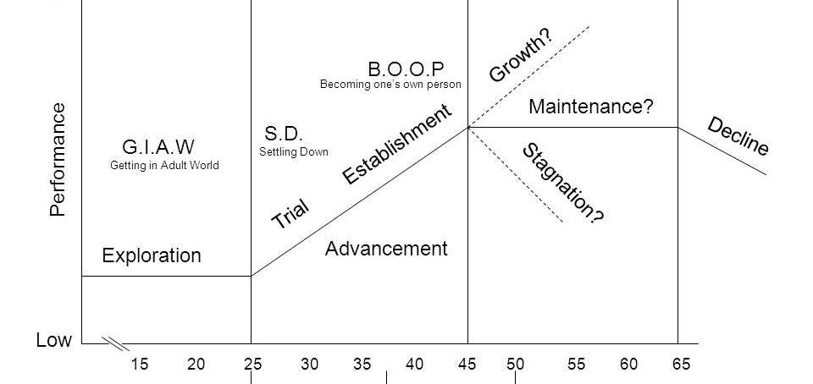

Slide 26
Career Stages at Work
How our career stage may affect the transition and change
Linear throughout life
Exploration stage
School-to-work stage
→ self-examination and education fulfillment
Establishment stage
Employed & finding a niche and specialization
Maintenance Stage
Learning & updating skills in specific field
Disengagement Stage
Retirement
Recycling
Notes:
note

Slide 27
= Recycling
This is the stage for Career Shifting. Back to previous development stages. From Establishment, back to exploration field again

Slide 28

Cause of
Recycling:
Personal crisis/trend shifting/
stuck at career path
Implies to frustrations for future-self uncertainty. E.g: being repeatedly passed over the promotions.
Recycling defined as process when an individual returns to the developmental tasks and concerns of an earlier career stage
Will earn a new learning (college degree or trainings) or change occupations
Organizational merger and feelings
of being burnt-out.
Present environment not empowering or rewarding to stay at the same field or career.
will work for transition to more meaningful or less stressful work.

Slide 29

Career Stages at Work
How our career stage may affect the transition and change
Exploration stage
School-to-work stage
→ self-examination and education fulfillment
Establishment stage
Employed & finding a niche and specialization
Maintenance Stage
Learning & updating skills in specific field
Disengagement Stage
Retirement
Recycling
Notes:
note

Slide 30
Series of mini-stages on career development
(driven by constant learning and mastery across functions, organizations, and other work boundaries)
Exploration
Trial
Establishment
Mastery
Exit
Across discipline, industry, field, and company

Slide 31
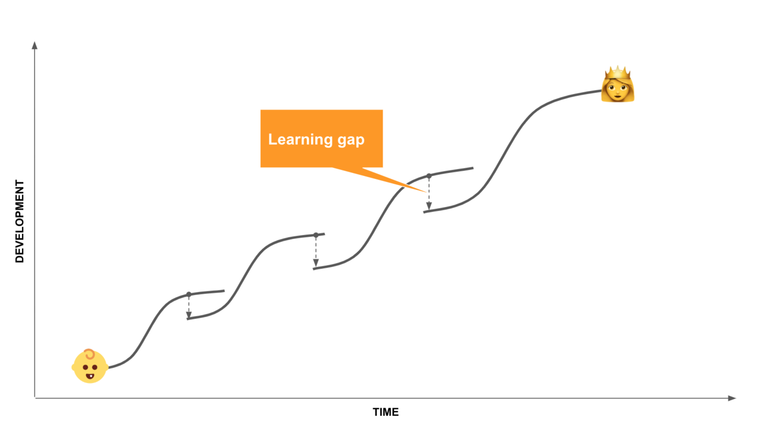

Slide 32
Of course, from every opportunity, there’s an option to take, and from every option, there’s always a consequence: the price to pay

Slide 33
Outline Pembelajaran
Understanding Career Shifting: The Opportunity and Consequences
How the world is changing so fast?
Defining our goals and market needs
Understanding the Opportunities for Digital Jobs
Career Maturity
How is your Career Readiness?
Understanding the Career Stages
Understanding the Consequences for Career Shifting
Rakamin Profiler
Notes:
Diisi seluruh subtopik yang akan dipelajari

Slide 34



Anything in This World
Is Basically, Transactional
Mother and Child
Currency: Responsibilities, love, cuteness, belongingness
Romantic Relationship
Currency: Commitment, love, physiological needs, intimacy
Career
Currency: Skill-set, trust, network, salary, learning

Slide 35


Anything in This World
Is Basically, Transactional
This is you, you want to get some ‘benefit’ you perceived valuable
The owner can give you the ‘benefit’ if they also get some value
Benefit
You have the currency (can be anything)
Owned by someone/ something
You give enough amount of the currency to the ‘benefit’ owner

Slide 36
Anything in This World
Is Basically, Transactional
This is you, you want to get some ‘benefit’ you perceived valuable
The owner can give you the ‘benefit’ if they also get some value
Benefit
= Resources
You have the currency (can be anything)
Owned by someone/ something
You have the currency (can be anything)
You give enough amount of the currency to the ‘benefit’ owner
The more resources you have, the more ‘benefit’ you can get, basically you can ‘buy’ many things successfully

Slide 37

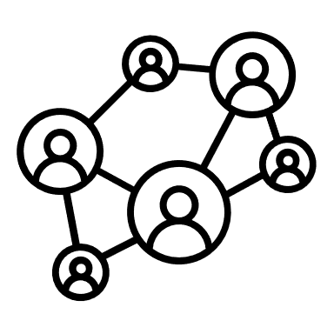

What we Define as a Resources? (focusing on career success)
Money
Network
Knowledge & Skills
These are the most fundamental resources that everyone can get by dedication and hard work
These resources are not inherited unless we have a sultan parents :) or lucky enough to have parents that can connect us to so many important person

Slide 38
The most fundamental resources, that can be used as a currency to mostly anything,
is knowledge and skills
Investment to knowledge and skills give the highest return

Slide 39
But we need to pay high price to have high knowledge and skills

Slide 40
Let’s Take a Look to This Framework Again
This is you, you want to get some ‘benefit’ you perceived valuable
The owner can give you the ‘benefit’ if they also get some value
Benefit (get a decent job)
You have the currency (can be anything)
Owned by someone/ something
You give enough amount of the currency to the ‘benefit’ owner

Slide 41
Outline Pembelajaran
Understanding Career Shifting: The Opportunity and Consequences
How the world is changing so fast?
Defining our goals and market needs
Understanding the Opportunities for Digital Jobs
Career Maturity
How is your Career Readiness?
Understanding the Career Stages
Understanding the Consequences for Shifting Career
Rakamin Profiler
Notes:
Diisi seluruh subtopik yang akan dipelajari

Slide 42
Defining our goals, market needs, and our resources
Let’s open Rakamin Career and Learning Plan

Slide 43


Defining our goals
Get a new job as a Digital Marketer (shifting)
Accelerate my Career as a Digital Marketer (upgrading)
Notes:
Note

Slide 44
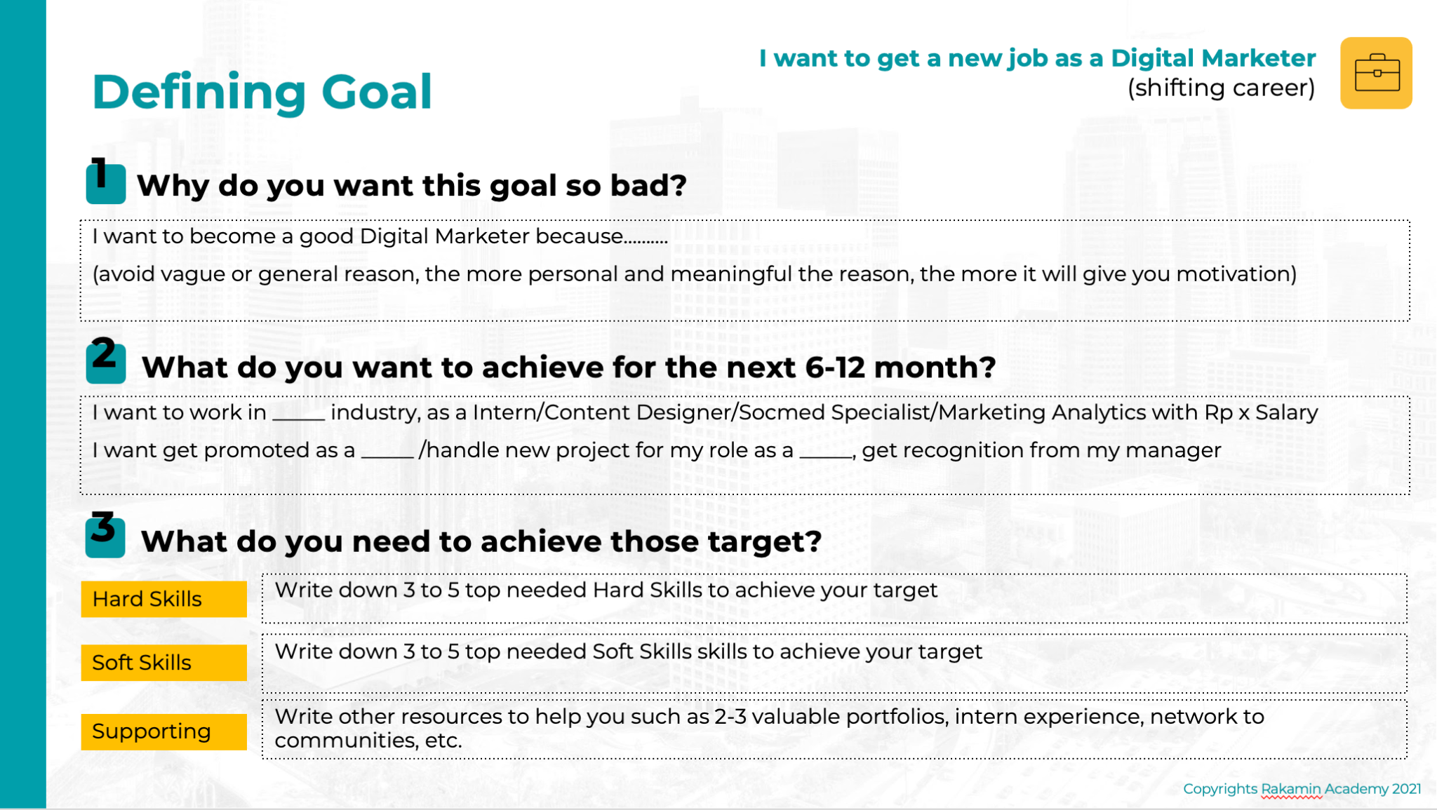
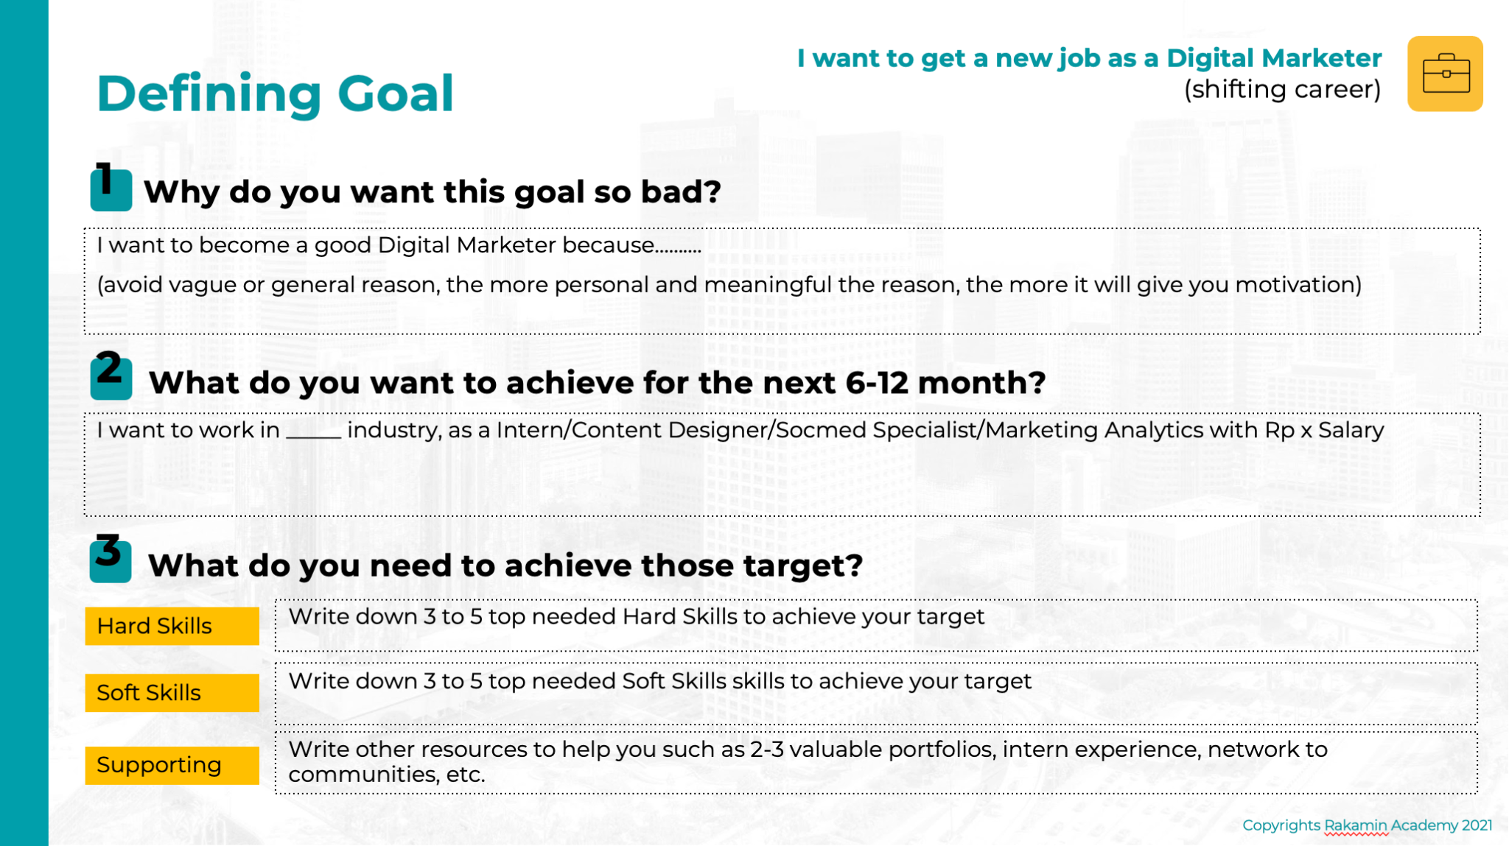

Slide 45
I want to accelerate my career as a Digital Marketer (upgrading)
Understanding Market Needs
Hard Skills
Soft Skills
From every roles, there’s a job desc, and set of skills needed
Supporting

Slide 46
I want to accelerate my career as a Digital Marketer (upgrading)
Understanding Market Needs
Hard Skills
1. Content creation 2. Content optimization 3. Social media and internet marketing 4. User research
Soft Skills
1. Presentation skills 2. Team leadership
Get promoted as a Content Marketing Lead
Supporting
1. Experience leading small campaign 2. Become a speaker and get recognition 3. Teaching my co-workers

Slide 47
I want to accelerate my career as a Digital Marketer (upgrading)
Understanding Market Needs
Hard Skills
1. SEO optimization 2. Copywriting 3. Keyword Research and Data Analysis
Soft Skills
1. Time management (to provide more productivity) 2. Communication Skills
Get promoted as a SEO Specialist
Supporting
1. Finishing online certification 2. Handle more freelance project 3. Create 3 new portfolio

Slide 48
I want to get a new job as a Digital Marketer (shifting career)
Understanding Market Needs
Hard Skills
1. Facebook and Google Ads 2. Google Analytics 3. Business process and market behavior 4. Content marketing
Soft Skills
1. Presentation skills 2. Critical Thinking
Get job as a Digital Marketing Officer
Supporting
1. Intern experience in related roles 2. 2-3 valuable portfolio related to social media management and ads optimization

Slide 50
Outline Pembelajaran
Understanding Career Shifting: The Opportunity and Consequences
How the world is changing so fast?
Defining our goals and market needs
Understanding the Opportunities for Data Science Jobs
Career Maturity
Understanding the Career Stages
How is your Career Readiness?
Understanding the Consequences for Shifting Career
Rakamin Profiler
Notes:
Diisi seluruh subtopik yang akan dipelajari

Slide 51
You’re halfway there!
You already know the market needs.
But to achieve your goal, what do you really need to prepare?

Slide 52
Career Stages at Work
How our career stage may affect the transition and change
Linear throughout life
Exploration stage
School-to-work stage
→ self-examination and education fulfillment
Establishment stage
Employed & finding a niche and specialization
Maintenance Stage
Learning & updating skills in specific field
Disengagement Stage
Retirement
Notes:
note

Slide 53
What do you really need to prepare?

Slide 54
Company can’t really know your hard skills and soft skills directly.
You need to show it!

Slide 55
Increase our
Career Maturity
Career maturity is person’s degree of adaptability in career decision making and readiness to make occupational choices.
Concern
Gather first all your concern and uncertainty
Formulate solution in the process of making career decisions.
Curiosity
Exploring work world
Seeking information about jobs requirements.
Confidence
Must have belief in your ability to make sensible career decisions and realistic profession choices.
Consultation
Assistance in career decision making by requesting information or advice from others.
1
2
3
4

Slide 56
By now, you understand that the career shifting requires a lot of hard work. That’s why we need to understand about: Career Readiness

Slide 57
Outline Pembelajaran
Understanding Career Shifting: The Opportunity and Consequences
How the world is changing so fast?
Defining our goals and market needs
Understanding the Opportunities for Digital Jobs
Career Maturity
Understanding the Career Stages
How is your Career Readiness?
Understanding the Consequences for Shifting Career
Rakamin Profiler
Notes:
Diisi seluruh subtopik yang akan dipelajari

Slide 58





Career Shifting Processes (focusing on career success)
01
02
03
Career Awareness &
Decision Making
Resilience
Adjustment
Pre-shifting
Ongoing
Post-shifting
Preparations stage!
In this stage you will do a lot of research about market needs, you also upskilling your resource, understanding yourself deeper (personality, strength & weakness, self-concept, etc)
Execution Stage!
This is the most difficult and painful stage. You’re going to deal with interview process, rejections, tight deadlines, and all the preparation and training to get your desired career.
Adjustment Stage!
You got your dream job. And it’s time for you to upgrade your new mastery skills in professional life. Good luck on all the trainings and KPIs!

Slide 59
Career Shifting Processes (focusing on career success)
02
The question is:
01
03
Are you Ready?
Career Awareness &
Decision Making
Resilience
Adjustment
Pre-shifting
Ongoing
Post-shifting
Preparations stage!
In this stage you will do a lot of research about market needs, you also upskilling your resource, understanding yourself deeper (personality, strength & weakness, self-concept, etc)
Execution Stage!
This is the most difficult and painful stage. You’re going to deal with interview process, rejections, tight deadlines, and all the preparation and training to get your desired career.
Adjustment Stage!
You got your dream job. And it’s time for you to upgrade your new mastery skills in professional life. Good luck on all the trainings and KPIs!

Slide 60
For Career Shifting,
It’s indeed a long process and required a lot of work and resilience. To know what the best treatment and strategy that suitable for you, you need to understand about yourself and resources

Slide 61
Outline Pembelajaran
Understanding Career Shifting: The Opportunity and Consequences
How the world is changing so fast?
Defining our goals and market needs
Understanding the Opportunities for Digital Marketing Jobs
How your Career Readiness work ?
Understanding the Career Stages
How is your Career Readiness?
Understanding the Consequences for Shifting Career
Rakamin Profiler
Notes:
Diisi seluruh subtopik yang akan dipelajari

Slide 62
After understanding your goals, what market needs, and your initial maturity level, the next step is
to understand your resources

Slide 63
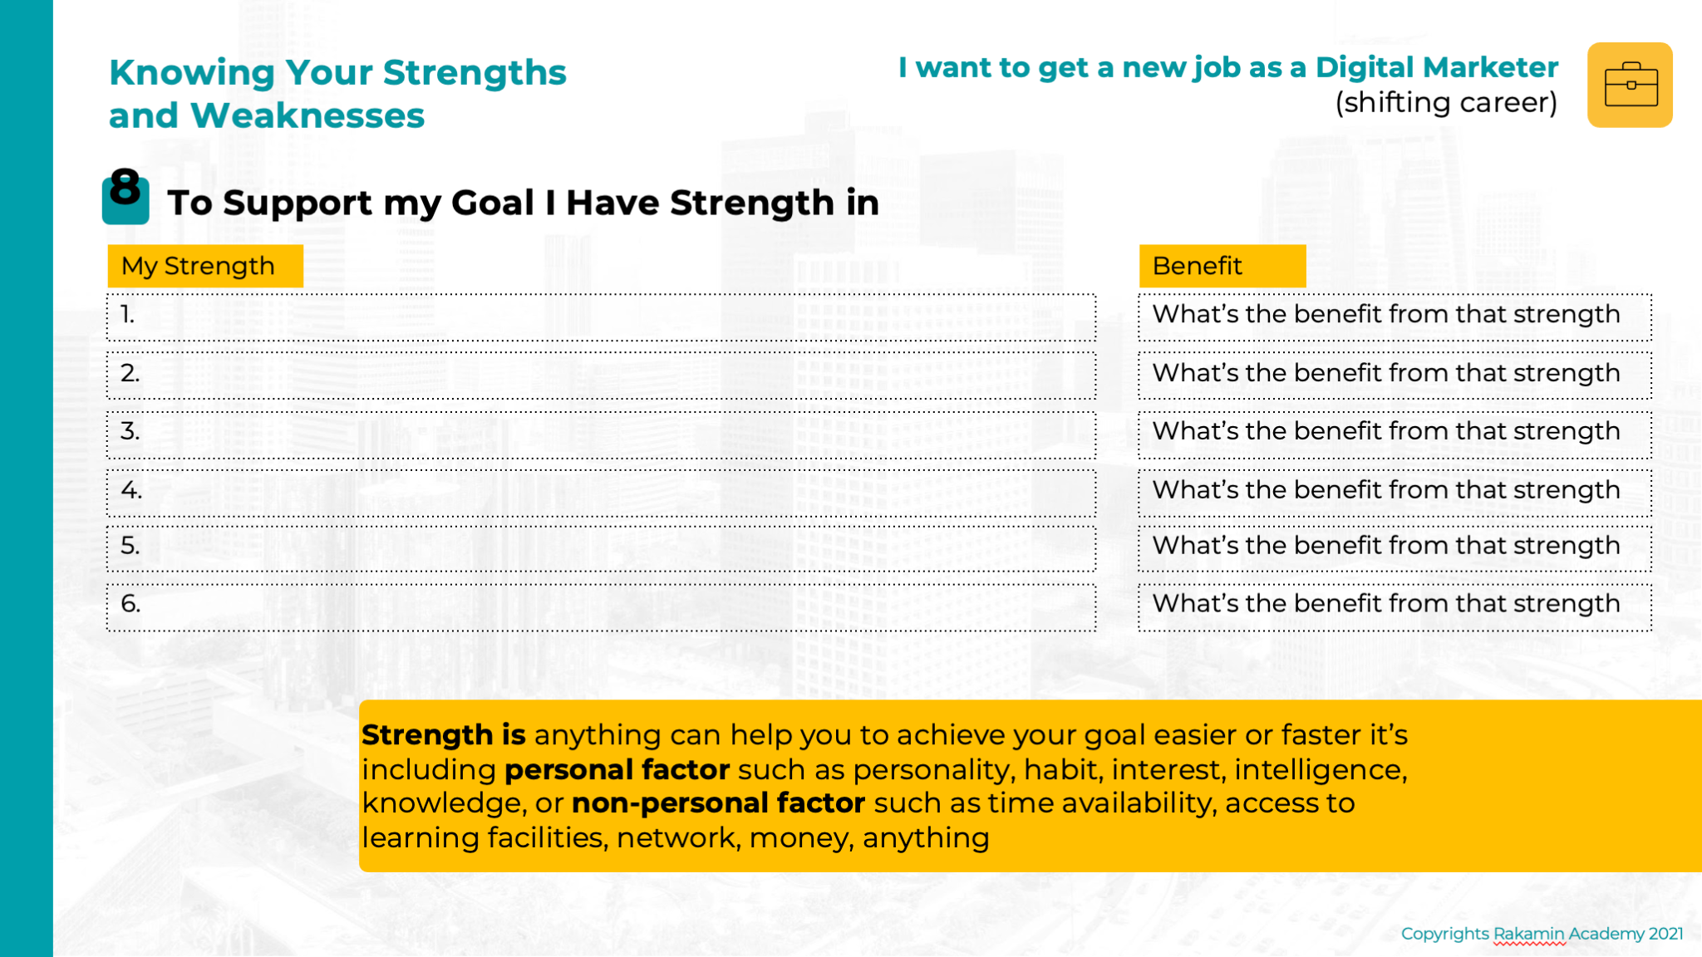

Slide 64
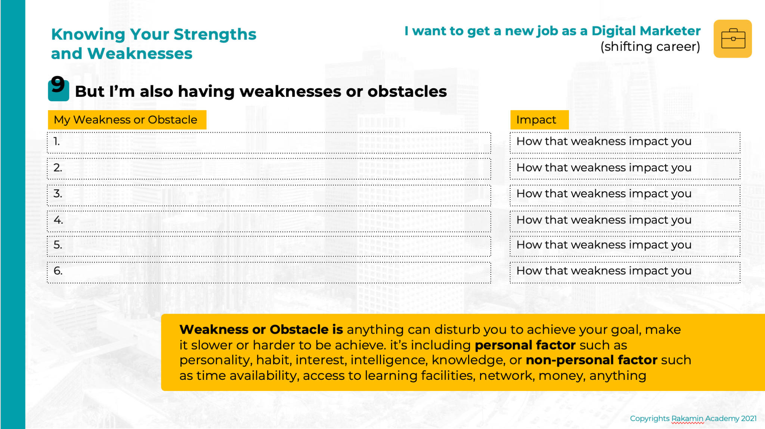

Slide 65


Slide 66
Rakamin Personal Profiler: What is it?
Produk asesmen psikologis yang dikembangkan berdasarkan teori psikologi dan psikometri, sudah teruji valid dan reliabel untuk mengukur aspek kepribadian dan minat karier seseorang
Bertujuan untuk membantu siswa untuk mengenal diri secara holistik sehingga dapat memberi gambaran tentang aspek diri yang menonjol dan perlu dikembangkan untuk akselerasi karier di bidang teknologi
Memberikan gambaran mengenai contoh profesi di bidang teknologi digital beserta tingkat relevansi dengan profil siswa

Slide 67
Rakamin Personal Profiler Report
Rakamin Personal Profiler bisa diakses di profil masing-masing pada siswa yang sudah enrolled class
Asesmen terbagi menjadi dua bagian:
Bagian 1: Minat Karier → 60 soal. Estimasi durasi: 7-15 menit*
Bagian 2: Kepribadian → 100 soal. Estimasi durasi: 10-20 menit*
Cara pengerjaan asesmen dapat mengikuti instruksi di web Rakamin setelah login dan mulai Ikuti Tes
Setelah selesai mengerjakan, setiap student akan mendapatkan hasil di platform dan bisa di download dalam bentuk PDF
Student harus menyelesaikan semua soal di seluruh bagian asesmen baru akan mendapatkan hasil
Silakan menyelesaikan dan mendownload hasil laporan asesmen sebelum sesi minggu depan
*Tidak ada batasan waktu, durasi pengerjaan tergantung kecepatan setiap user

Slide 68
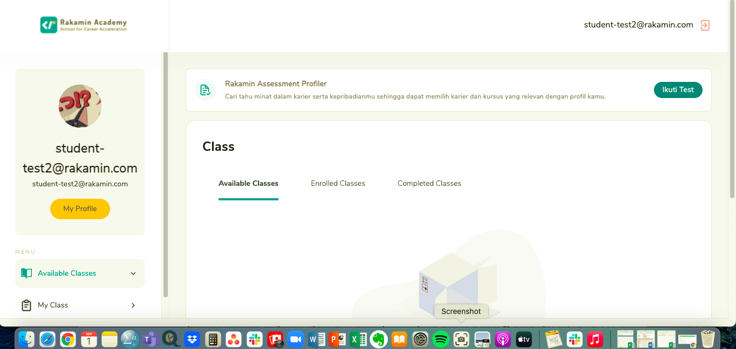
Tampilan Rakamin Personal Profiler di Dashboard

Slide 69
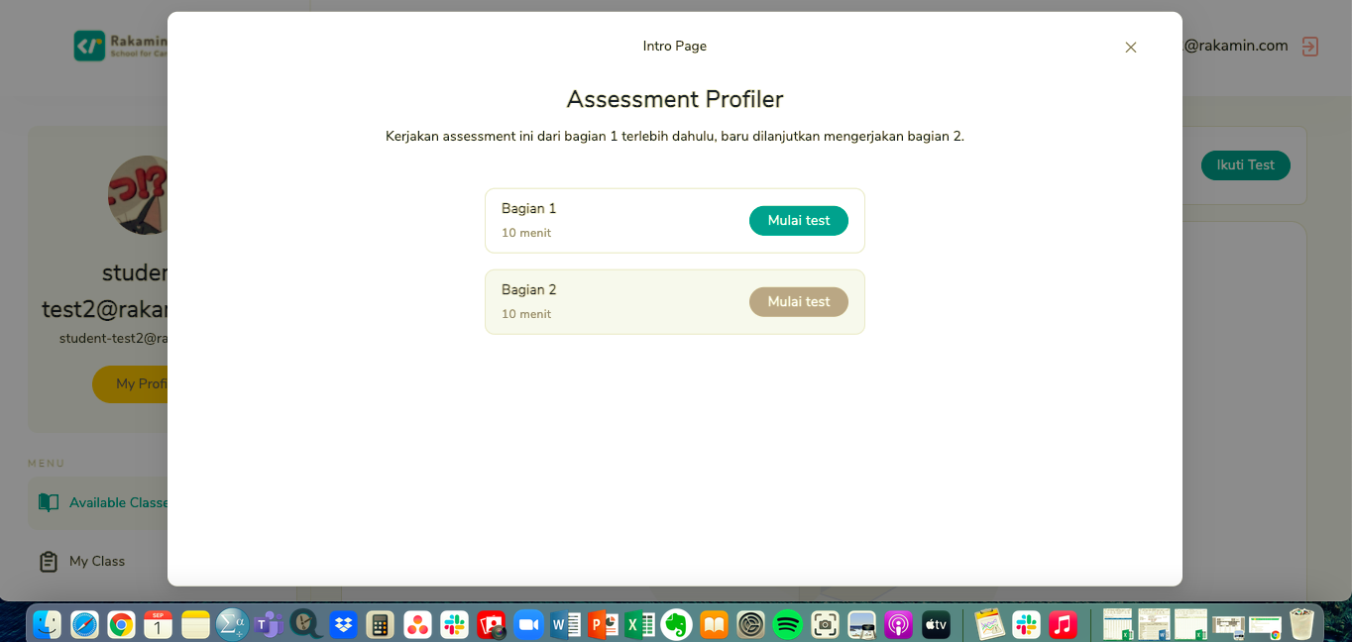
Bagian Asesmen

Slide 70
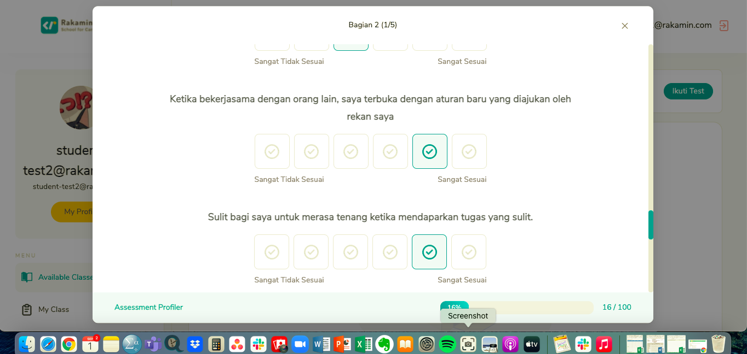
Contoh Pengerjaan Asesmen

Slide 71
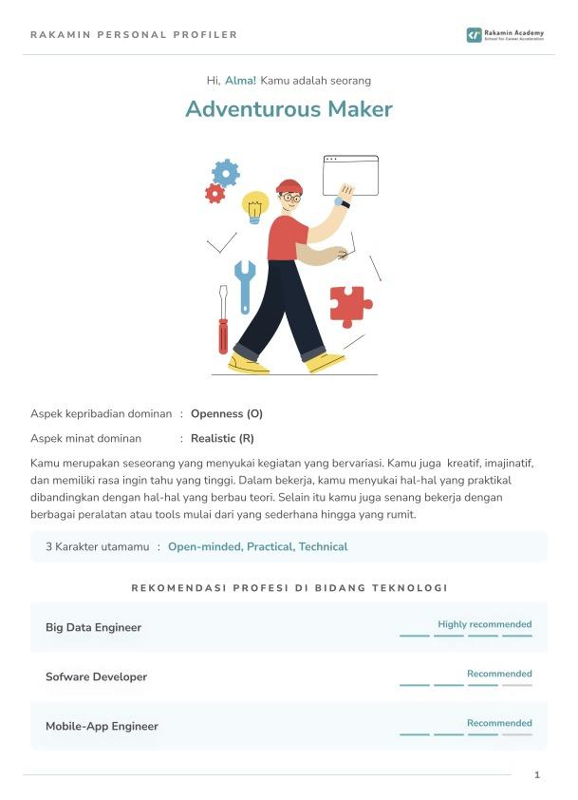
Contoh Laporan Rakamin Personal Profiler Report

Slide 72
Terima kasih!

Slide 73
Copyright Rakamin Academy
Dilarang keras untuk menyalin, mengutip, menggandakan, dan menyebarluaskan sebagian ataupun seluruh isi modul tanpa izin tertulis dari pihak penulis (Rakamin Academy)

